Slide 1
INDOOR OBSTACLE DETECTION AND FIRE RISK EVALUATION ROBOT
RBE 594 - Capstone Project, Fall 2022
Akaash Varatharajan, Devesh Datwani, Febin Fredi, Gokul Srinivasan
Notes:
Gokul: Good evening everyone. I am Gokul. Me and Team worked on Indoor Obstacle Detection and Risk Evaluation Robot for the Capstone project requirement. Currently we are in the month of December. For some it’s the first month of winter and for many it’s the month of Christmas. Now image the Christmas tree in your home caught on fire?

Slide 2
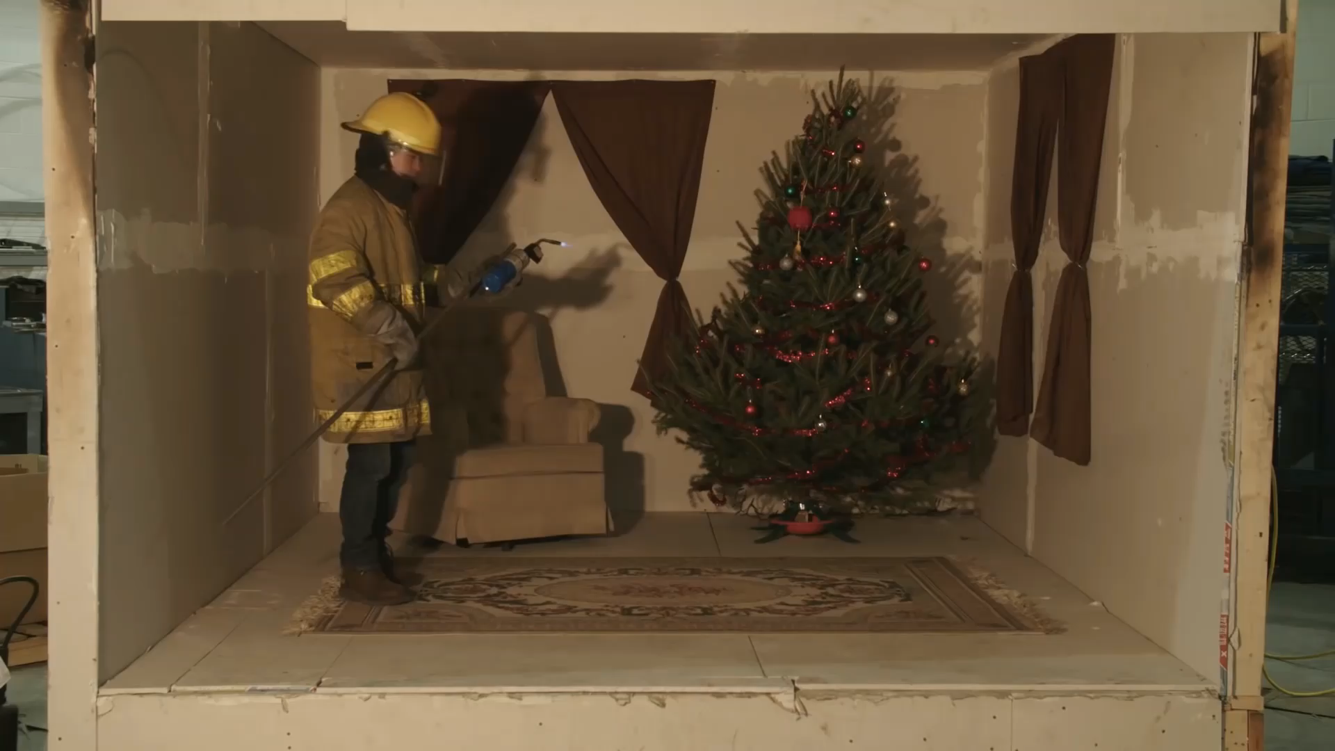
Notes:
Gokul: Currently, we are in December. For some it’s the first month of winter and for many it’s the month of Christmas. Now imagine this as a room in your apartment. A fire starts at the base of the Christmas tree. Lets observe how long it takes for the fire to engulf the house. It takes less than a minute for the fire to engulf the room.

Slide 3
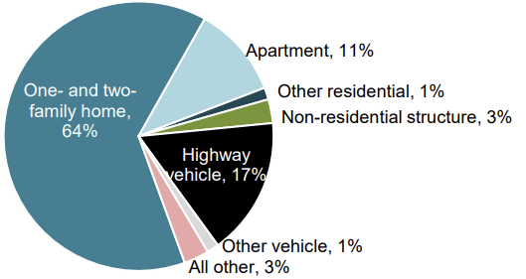
STATISTICS
Structure Fires | 486,500
Civilian Deaths | 3,010
Civilian Injuries | 12,600
Property Damage | $12.8B
Reported Structural Fires in 2021
Civilian fire deaths by incident type and occupancy: 2021
Notes:
Gokul: Reports from the National Fire Protection Agency states that, in 2021, out of the estimated 486,500 structure fires (36 percent of the reported fires) caused 3,010 civilian fire deaths (79 percent); 12,600 civilian injuries (86 percent); and $12.8 billion in direct property damage (80 percent).
he pie chart segregates the civilian fire deaths in structural fires based on the occupancy of the structures. It is pretty alarming that the majority of civilian deaths are from One and two family homes.

Slide 4
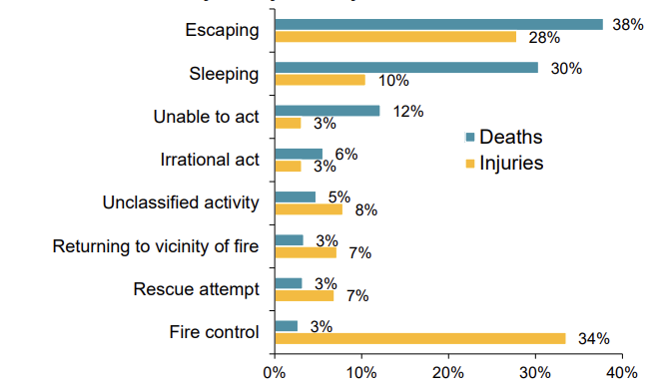
STATISTICS
Home fire deaths and injuries by activity when injured: 2015–2019
Notes:
Gokul:
From another report from the National Fire Protection Agency, bar graph that segregates fire deaths and injuries by activity when injured. It is concluded that the majority of the people died trying to escape the fire. While the deaths are generally attributed to smoke inhalation, escaping also included getting stuck, struggling to find safe paths and getting hurt by obstacles.

Slide 5
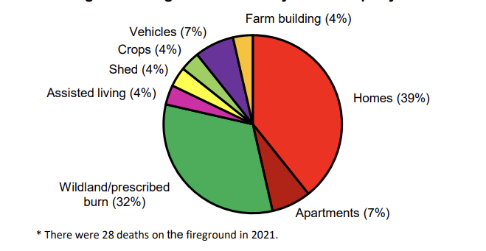
STATISTICS
Firefighters Fireground Death by Fixed Property Use*
Notes:
Gokul:
From another report from the National Fire Protection Agency, bar graph that segregates fire deaths and injuries by activity when injured. It is concluded that the majority of the people died trying to escape the fire. While the deaths are generally attributed to smoke inhalation, escaping also included getting stuck, struggling to find safe paths and getting hurt by obstacles.
Home is definitely dangerous
Even though we know our, we never know how thing affect this though during a [panic situation

Slide 6
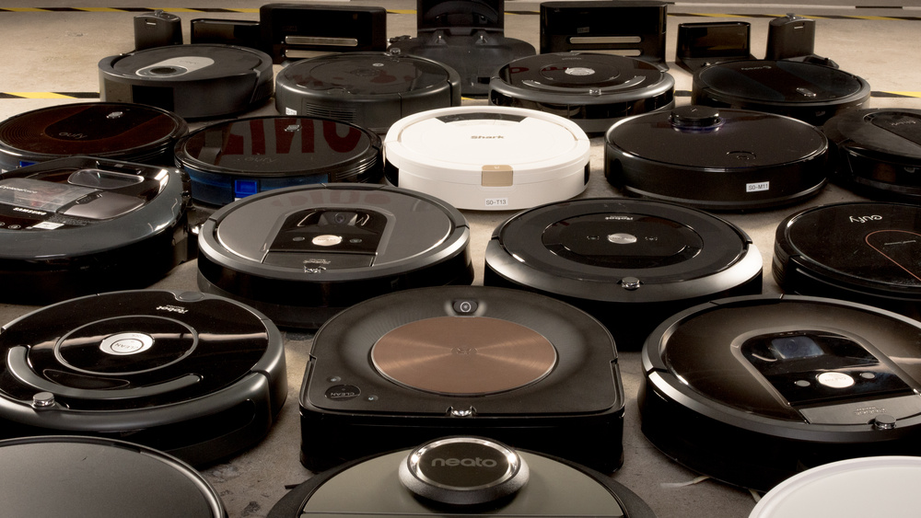
Notes:
Gokul:
Robotic Vacuum Cleaners like Roomba
It was estimated that there were 14.2 million households with robotic vacuum cleaners in the United States

Slide 7
STAKEHOLDER IDENTIFICATION
Householder
Academia
Firefighter
Notes:
Gokul:
Householder
The term householder refers to a person who occupies a house or tenement alone or as the head of a household. They are the primary users of the system.
Fire Department
The term fire Department refers to an organization that provides fire prevention and fire suppression services. While they are not the direct users of the system, the usage of this system will aid their operation as saving lives is their topmost priority.
Academia
The term refers to the academic world, particularly the WPI Robotics department and the WPI Fire Protection Engineering Department They are not the direct users of the system but have the expertise to provide feedback and assistance to the development of the system.

Slide 8
STAKEHOLDER’S NEEDS
Guidance to exit during emergency
Updates on obstacles in paths to exits.
Detection and Elimination of spot fires
Notes:
Gokul:

Slide 9
PROPOSED SOLUTION
Detects new obstacles on the floor
Evaluates a risk that the object presents in an emergency
Notifies the user to remove the obstacle
Maps floor frequently
Robotic Vacuum Cleaner
Notes:
Gokul:

Slide 10
SOFTWARE STACK
Gazebo 11
ROS Noetic
Turtlebot3 Packages
Turtlebot3 Simulation
Turtlebot3 Navigation
Tirtlebot3 G Mapping
Python 3.8
Scikit-learn 1.2
Notes:
Febin: These are the important software stacks:
Gazebo – Sim Environment
ROS – OS for running all packages
Turtlebot3 Packages – Simulation pkg for simulation in gazebo
- Navigation pkg to navigation stack
- Gmapping pkg for 2D Slam

Slide 11
METHODOLOGY
Mapping
Informed RRT*
Change Detection
Risk Scoring
Notes:
Febin: Mapping

Slide 12
NAVIGATION AND MAPPING
Navigation
Update goal
2D Slam Gmapping
Pipeline for Generating a 2D map
Notes:
Febin: A goal is published on the goal topic using a script. Robot moves towards the goal by following the path generated by the global planner and navigates using local planner. While on the move, Slam Gmapping is performed, creating a 2D map and updating it onto the original map data. Once goal is reached, a new goal is published and the process goes until the last goal is reached. Main Task: Generate 2D map of the unknown/ new environment using 2D Slam Gmapping

Slide 13
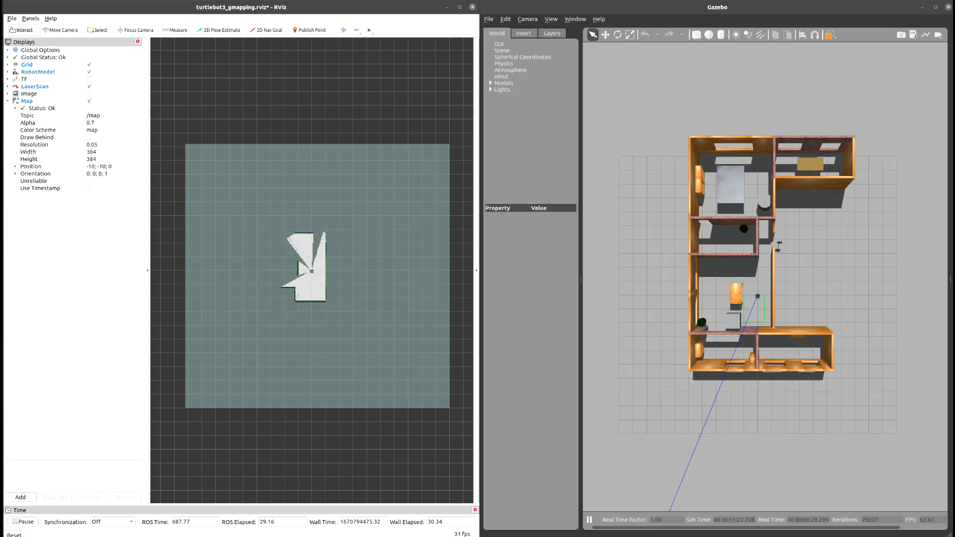
Notes:
Febin:
Since solution is in robotic vacuum cleaner, all objects present in the environment such as tables, chairs, couches are all included in ground truth
Explain RVIZ map
Output is an occupancy grid → Binary image map

Slide 14
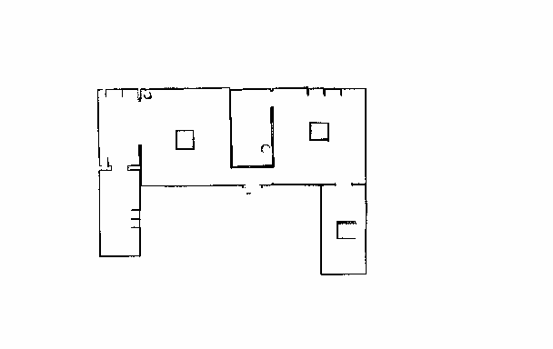
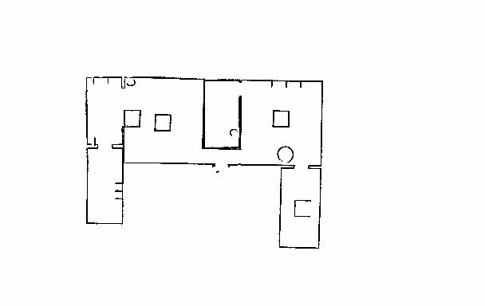
2D MAP GENERATION
Ground Truth Map
T=0
Current Map with obstacles
T=t
Legend
Furniture
Obstacles
Notes:
Febin: Explain the map (differences)

Slide 15
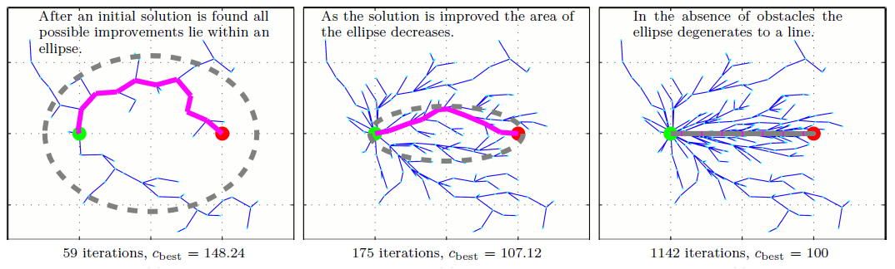
Informed RRT*
Why:
Probabilistic guarantees on completeness and optimality as RRT*
Better focused search, resulting in better optimal path
How it works:
Uses an Ellipsoid Heuristic to find optimal path
Notes:
Febin: Optimality and Heuristic, better path performance

Slide 16
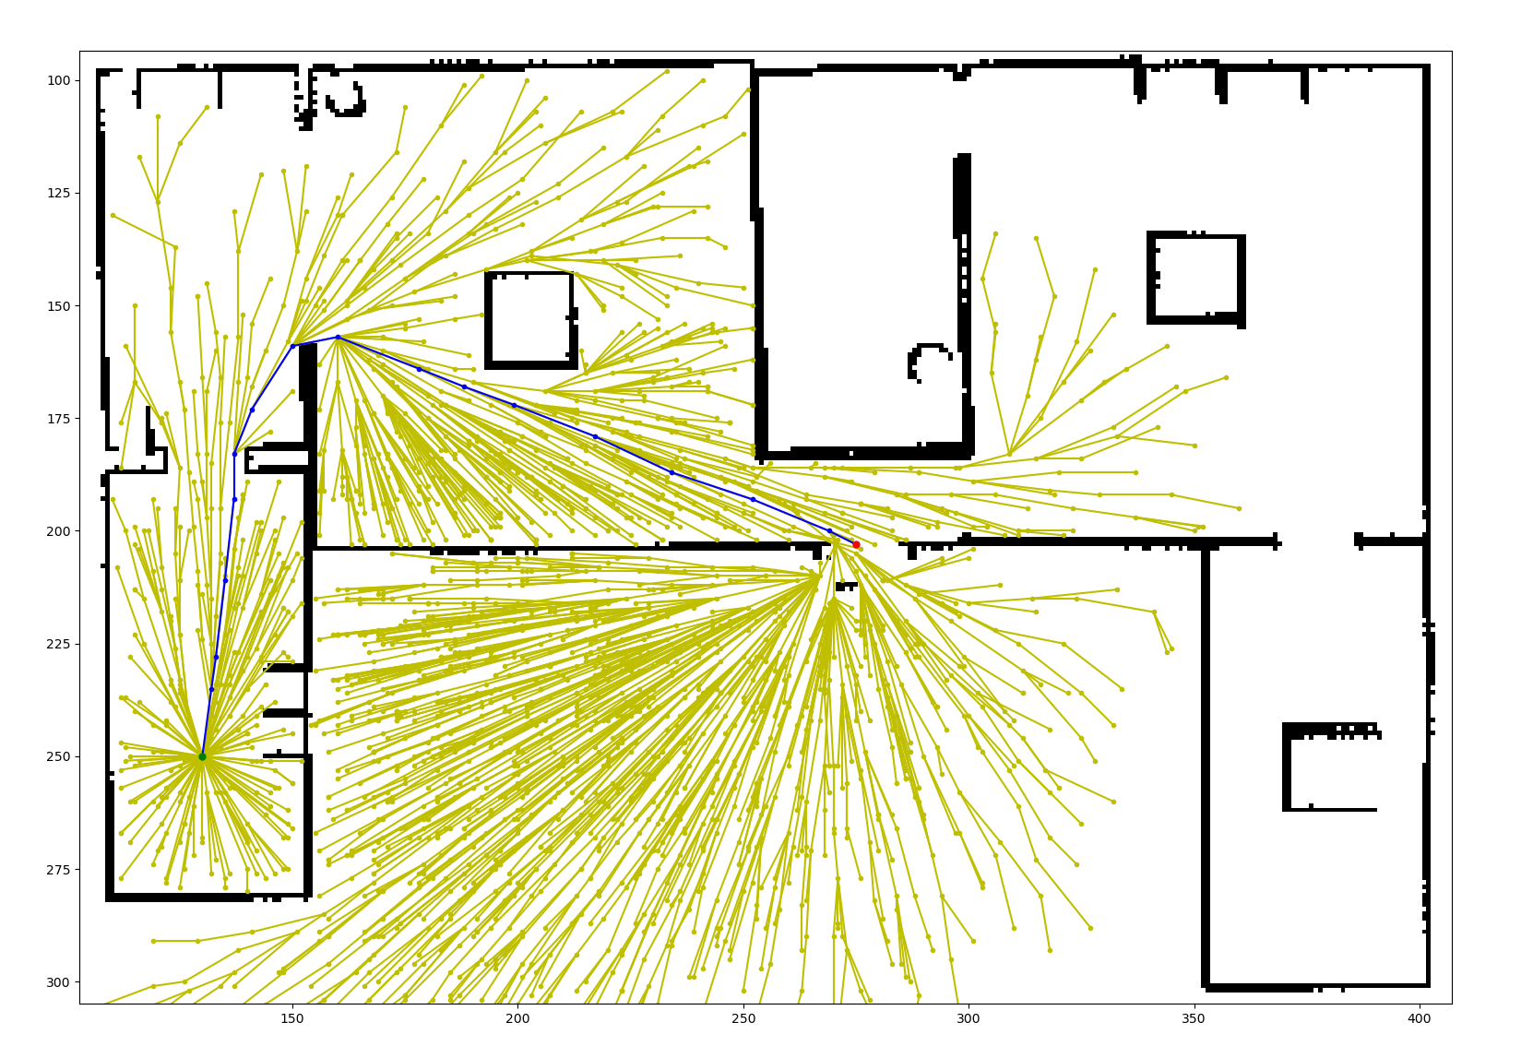
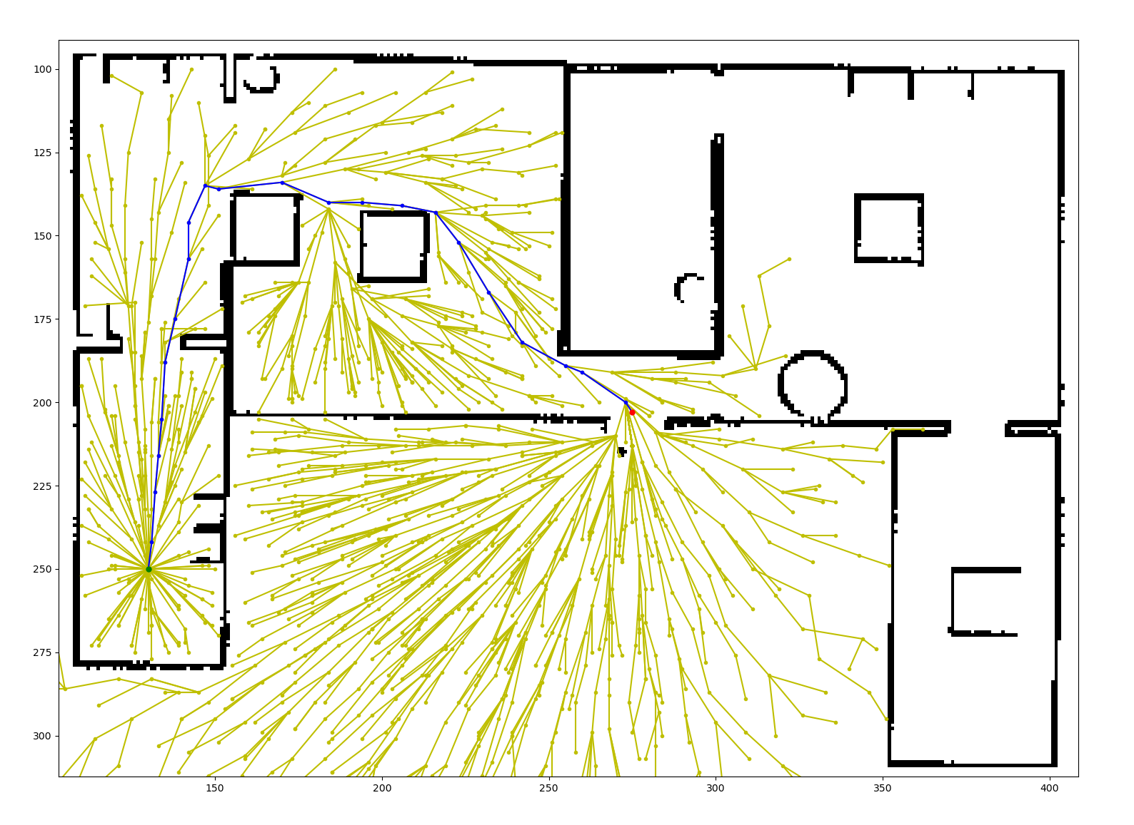
PATH GENERATION USING INFORMED RRT*
Start
Exit
Obstacles
Path Length: 229
Path Length: 266
Change: 16.16%
Notes:
Febin: Explain why path difference

Slide 17
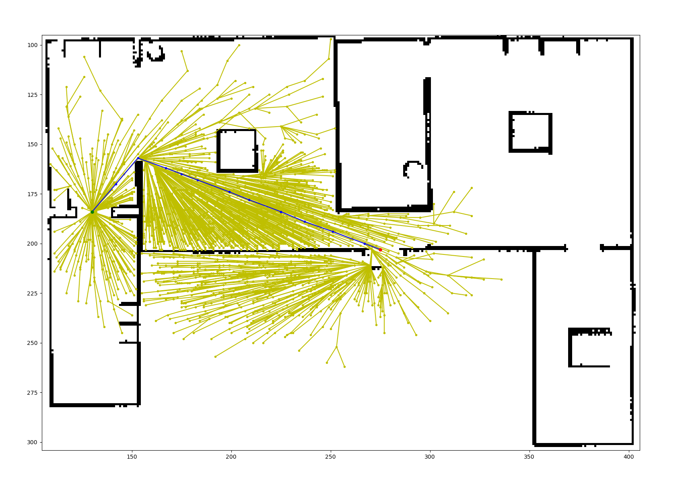
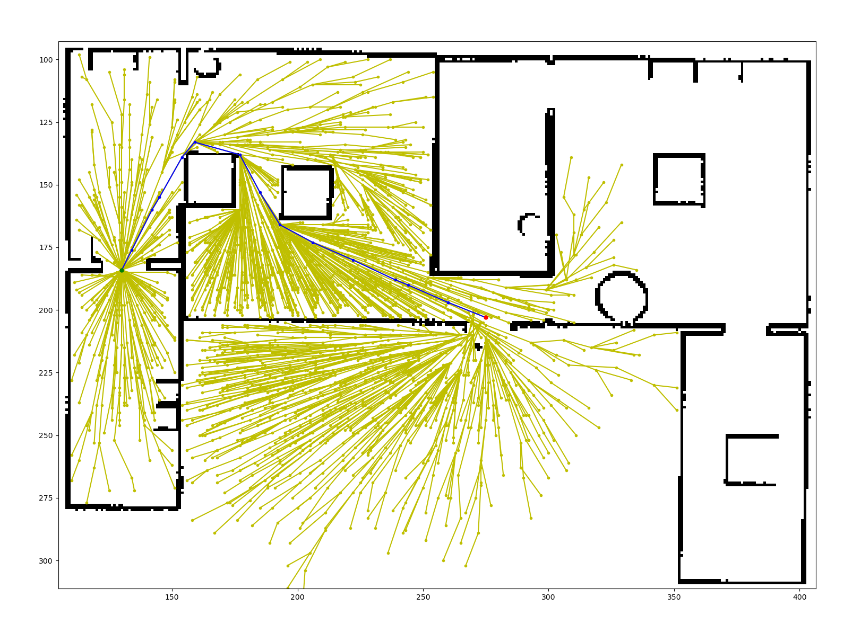
PATH GENERATION USING INFORMED RRT*
Start
Exit
Obstacles
Path Length: 165
Path Length: 200
Change: 21.21%
Notes:
Febin: Explain why path difference

Slide 18
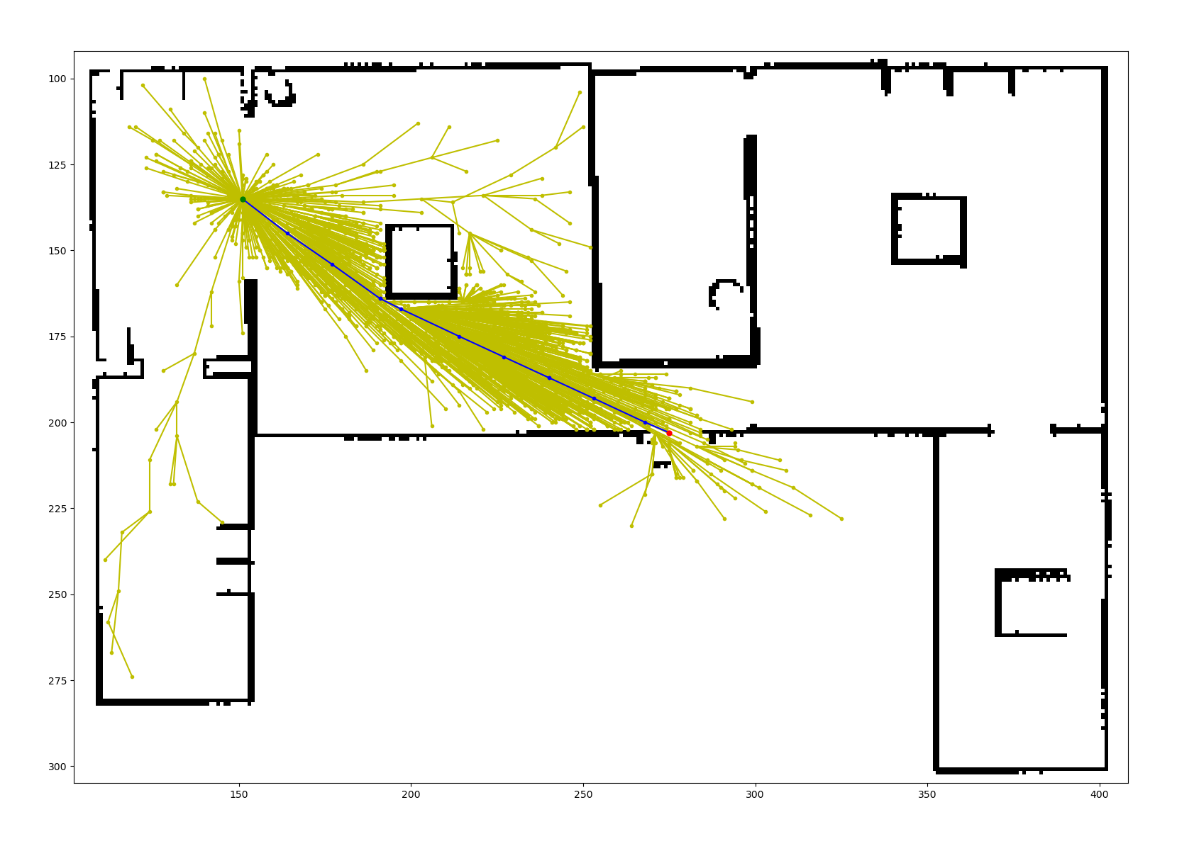
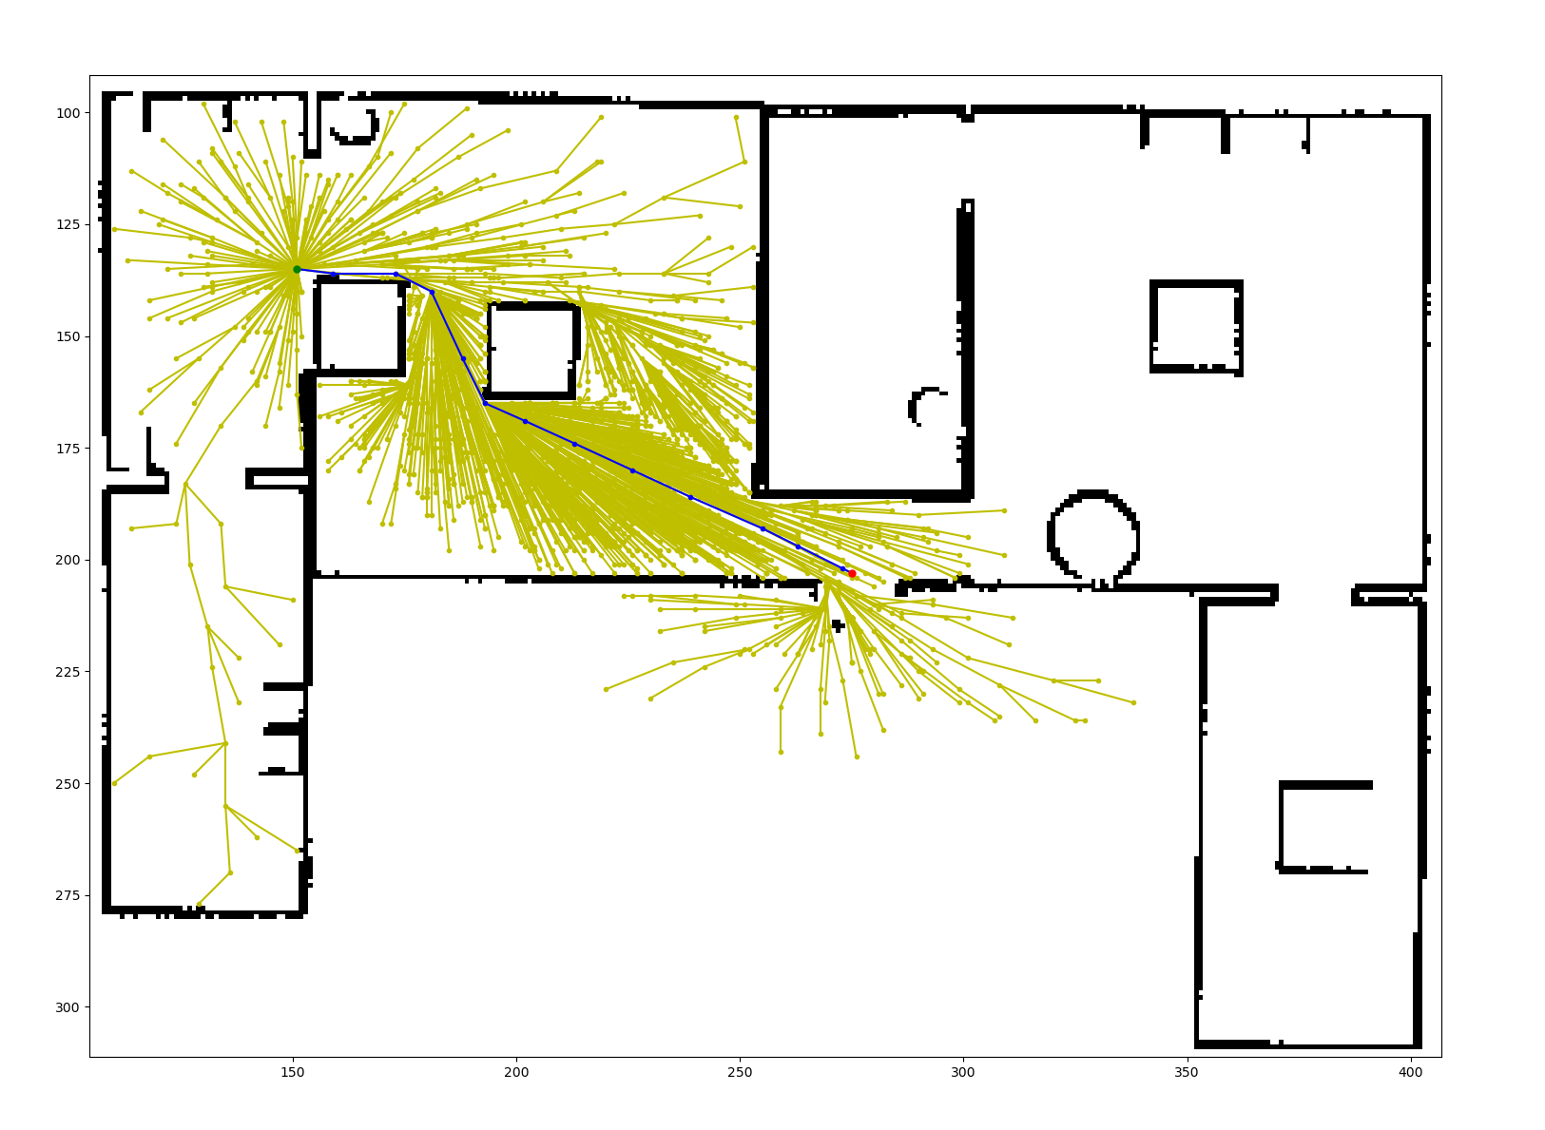
PATH GENERATION USING INFORMED RRT*
Start
Exit
Obstacles
Path Length: 142
Path Length: 149
Change: 4.93%
Notes:
Febin: Explain why path difference

Slide 19
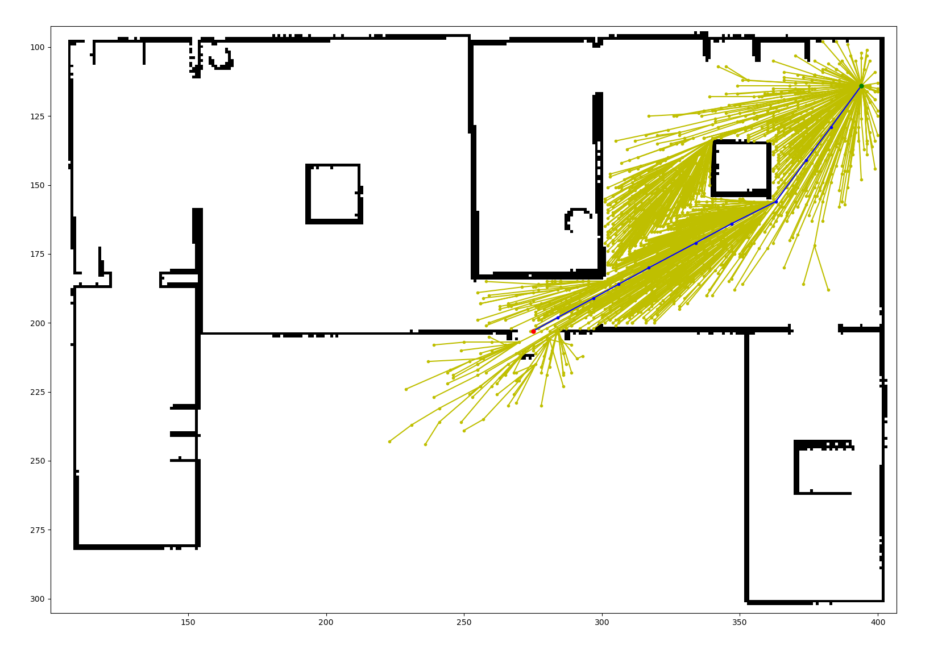
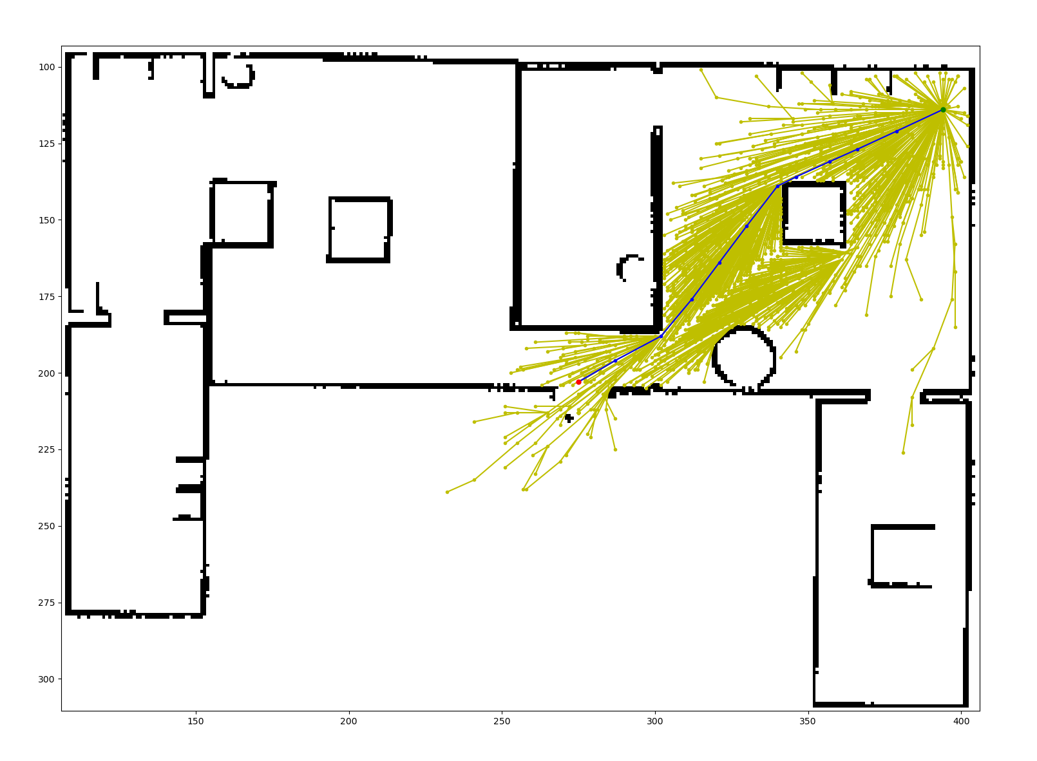
PATH GENERATION USING INFORMED RRT*
Start
Exit
Obstacles
Path Length: 152
Path Length: 152
Change: 0.00%
Notes:
Febin: Path length alone is not an ideal metric for scoring

Slide 20
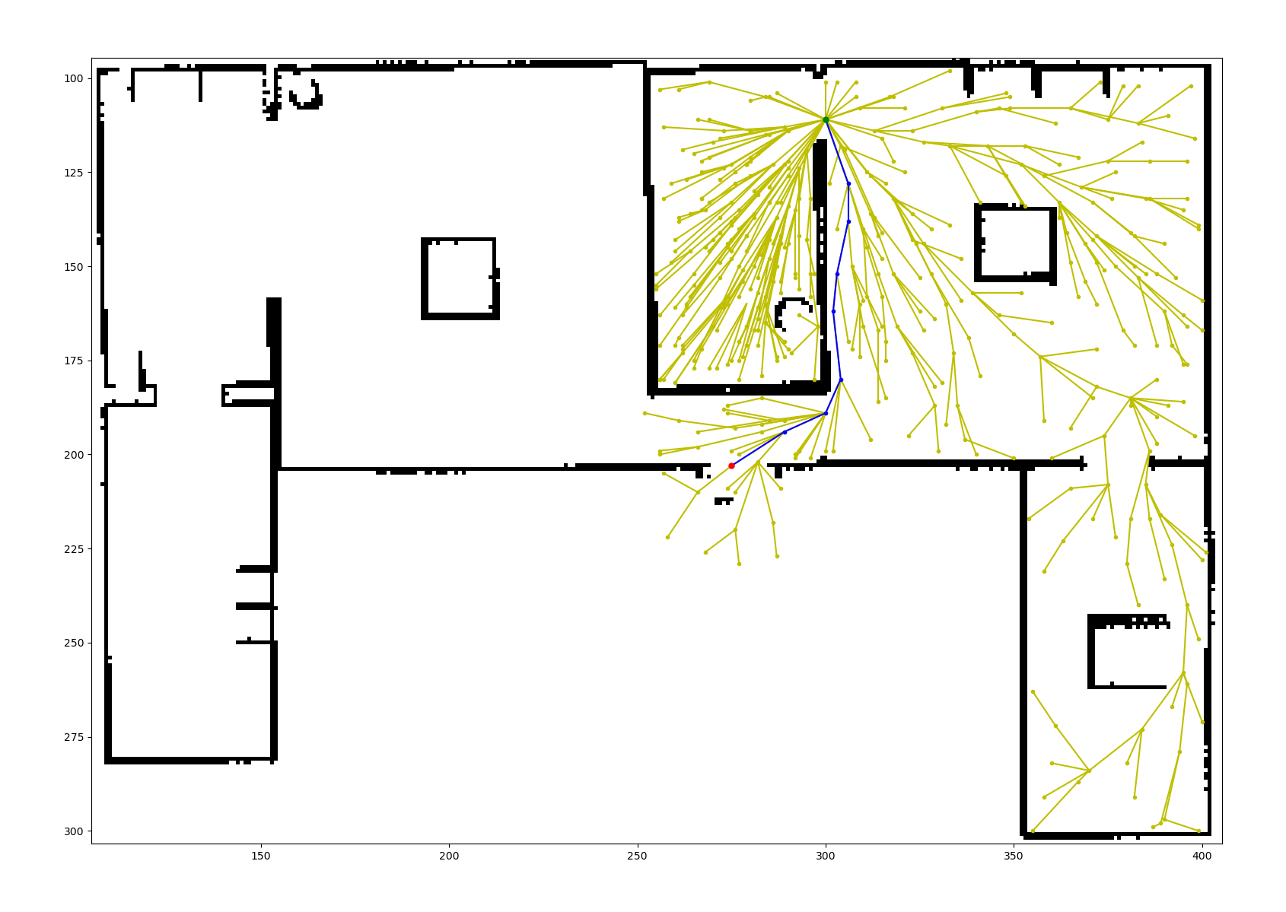
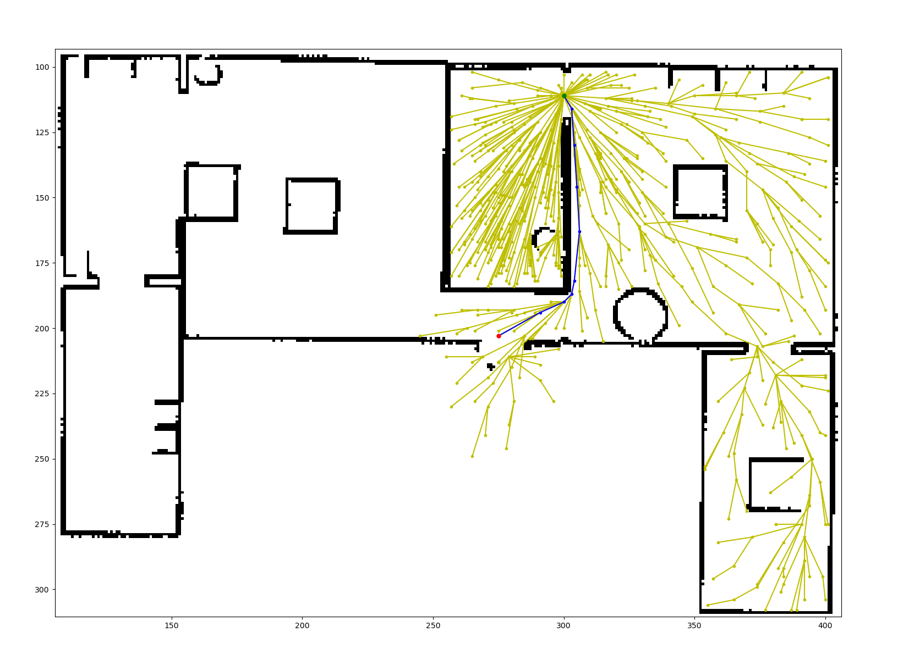
PATH GENERATION USING INFORMED RRT*
Start
Exit
Obstacles
Path Length: 109
Path Length: 107
Change: -1.83%
Notes:
Febin: Explain why path difference-------------------change path length values

Slide 21
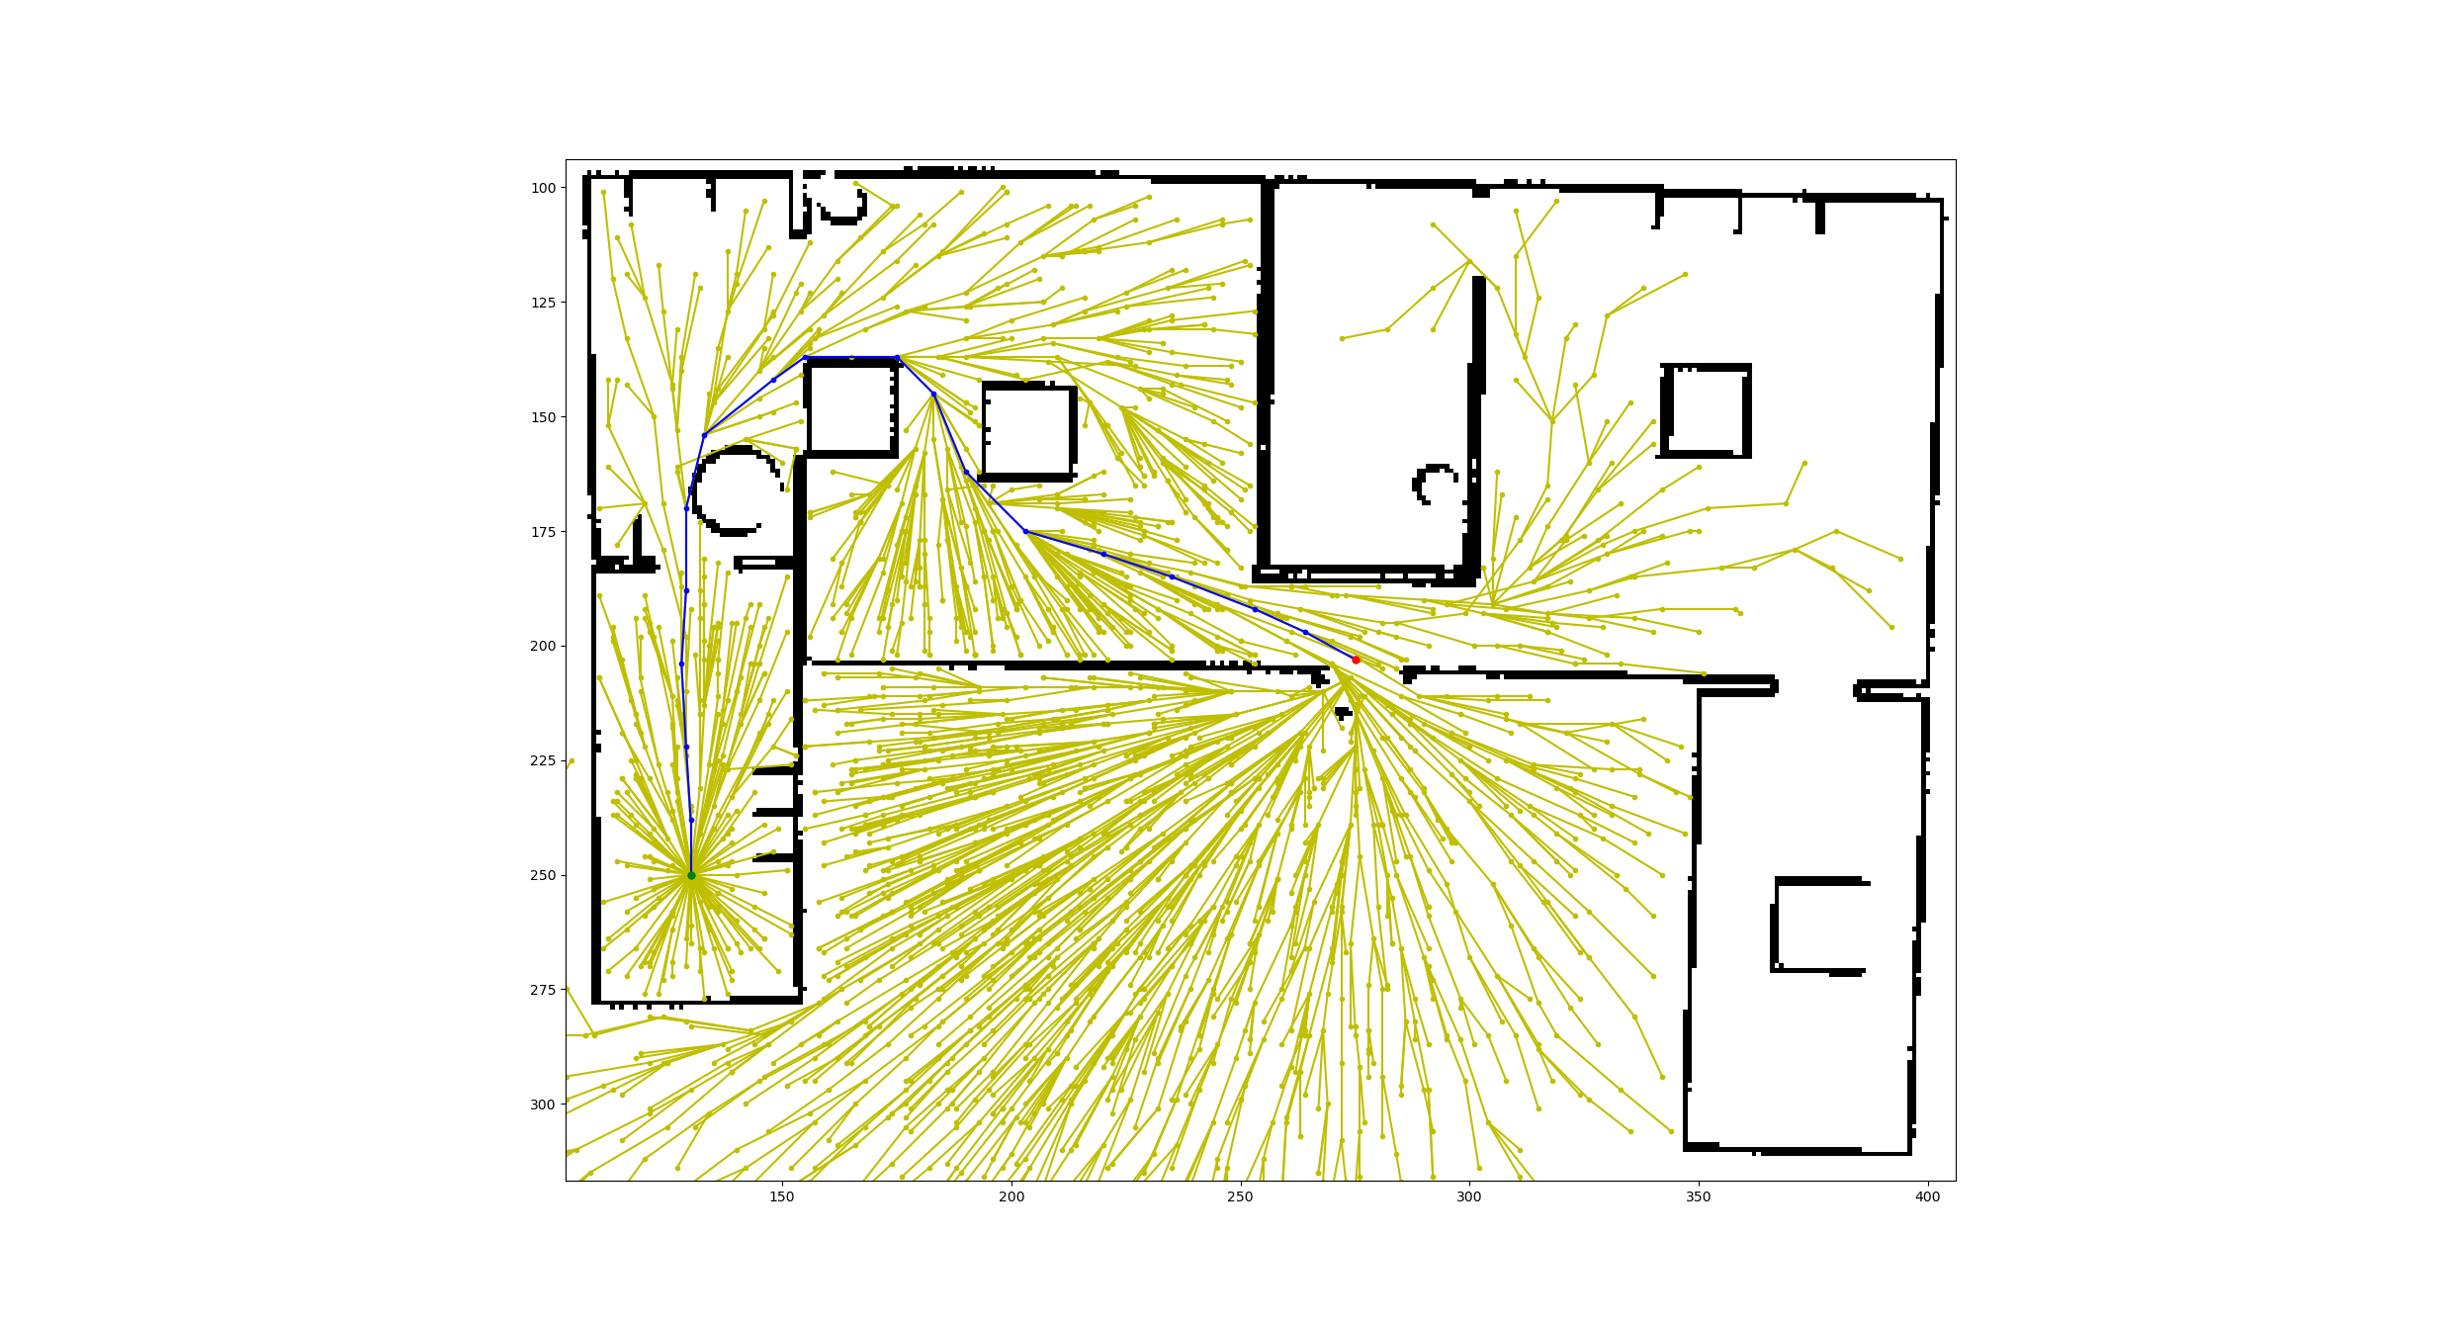
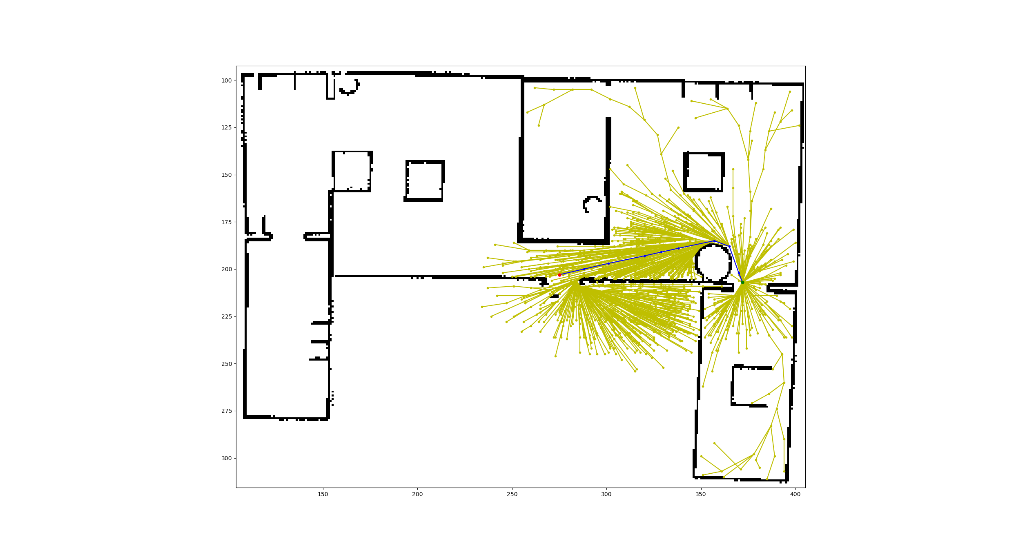
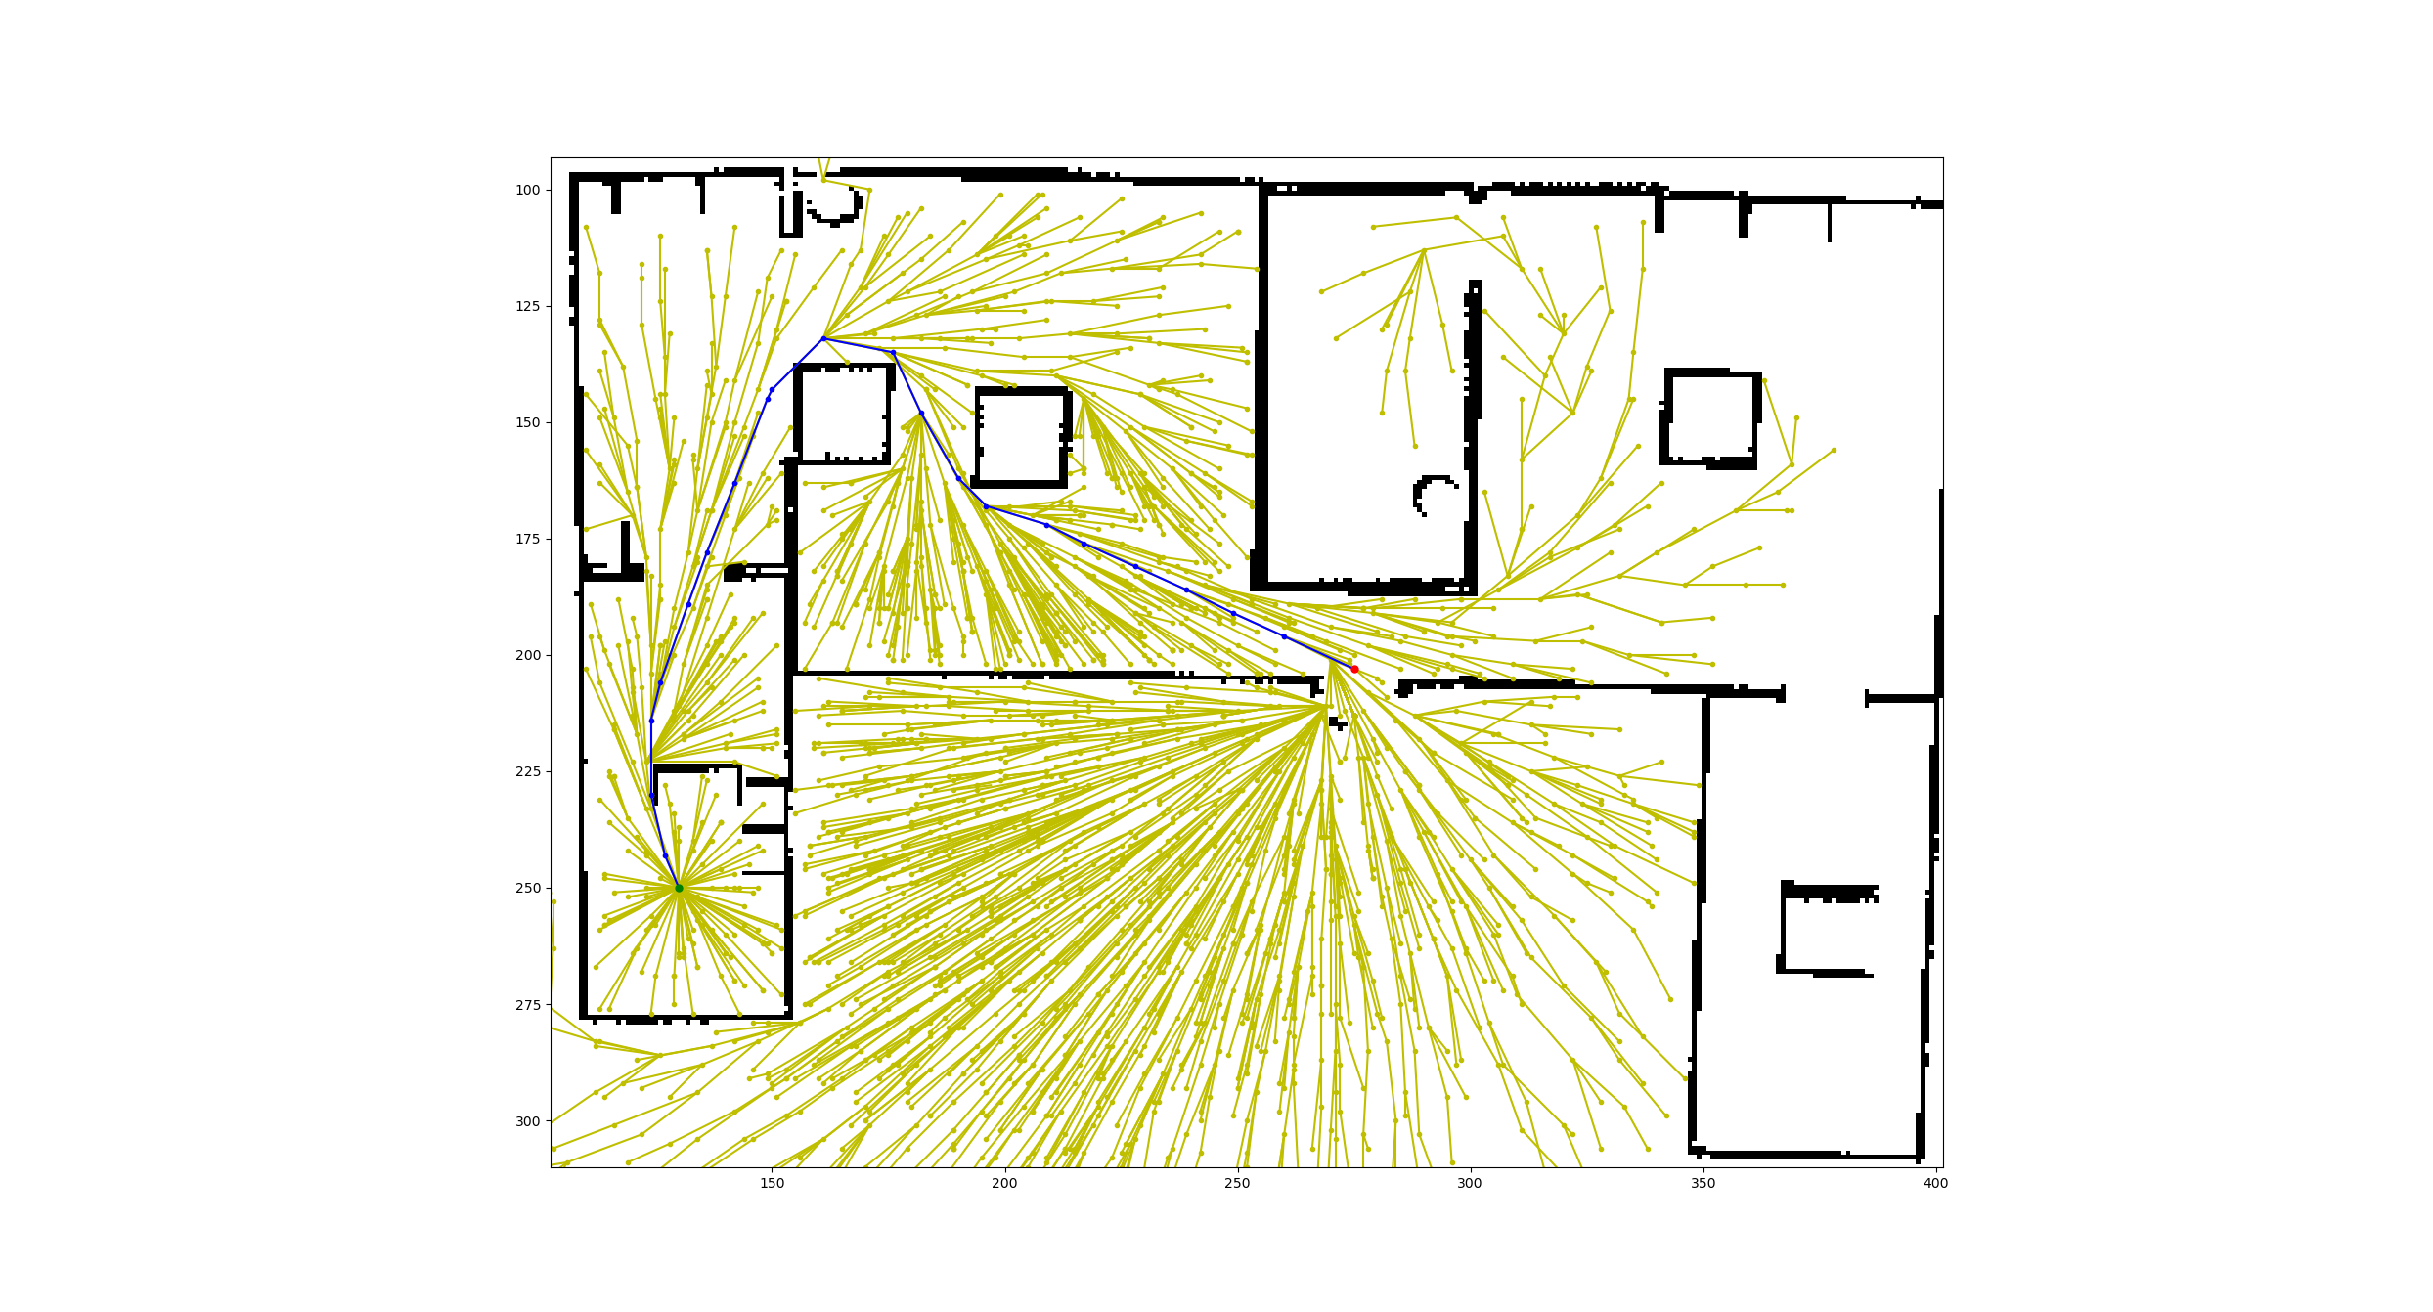
Different Obstacle Cases
Start
Exit
Exit
Start
Start
Exit
Case 1
Case 2
Case 3
Notes:
Febin: Different obstacle placements used for evaluation of scoring

Slide 22
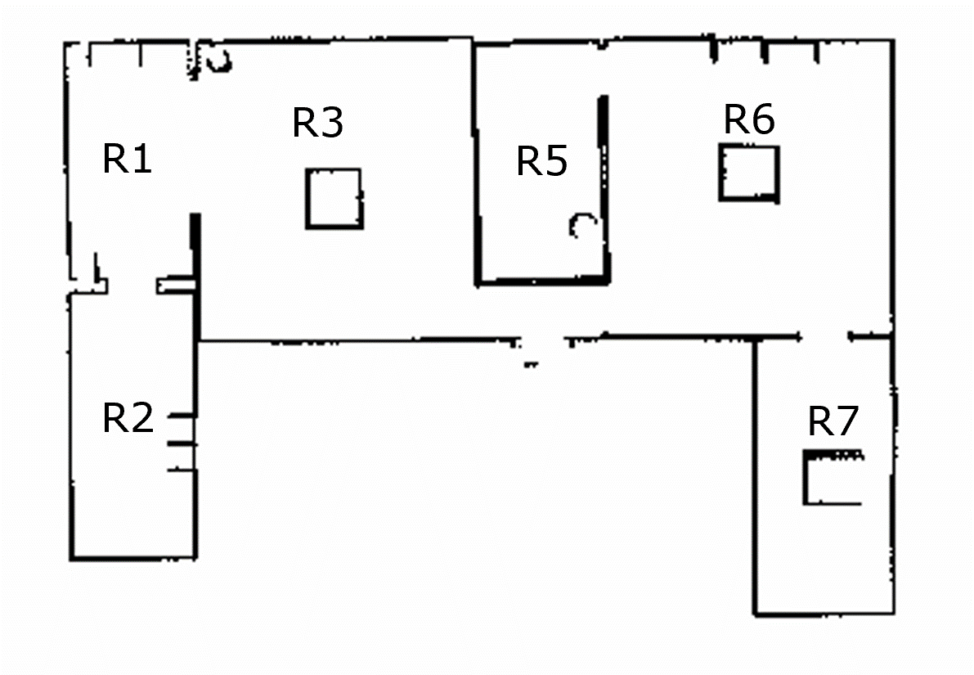
INFORMED RRT* PATH COMPARISON
Room | Ground Truth | Case 1 | Case 2 | Case 3
Room 1 | 142 | 149 | 149 | 142
Room 2 | 165 | 203 | 203 | 165
Room 2’ | 229 | 272 | 268 | 229
Room 5 | 106 | 106 | 106 | 111
Room 6 | 152 | 152 | 152 | 152
Room 7 | 97 | 97 | 107 | 107
R2’
* ALL VALUES IN UNITS
Notes:
Febin: Results for performing Informed RRT* path length on different maps
With combine results its evident that : increase in path length is evident of obstacle presence but the reverse is not always true

Slide 23


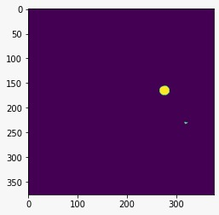
CHANGE DETECTION
Obstacle
Detected Obstacle
PCA + K-Means
Change Map
Exit
Exit
Ground Truth Map
New Map (real-time with obstacle)
Notes:
Devesh: Once the robot generates a map at given time, our system compares it with the ground truth map. The comparison gives us changes in the map

Slide 24
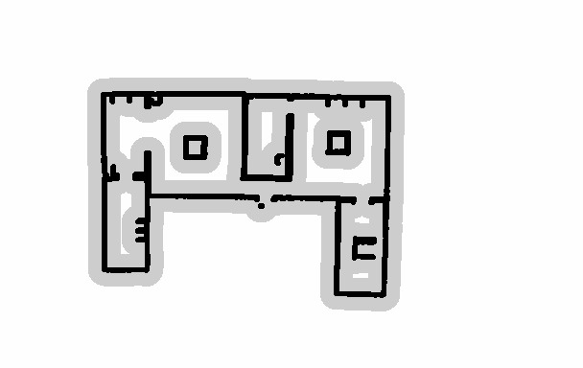
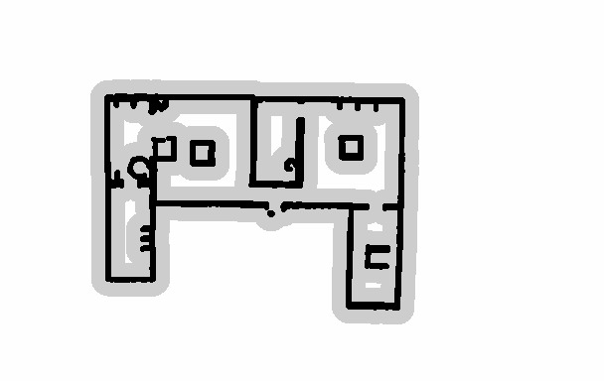

CHANGE DETECTION – Case:1
Obstacles
Detected Obstacles
PCA + K-Means
Change Map
Exit
Exit
Ground Truth Map
New Map (real-time with obstacle)
Notes:
Devesh: Need to mark obstacle

Slide 25
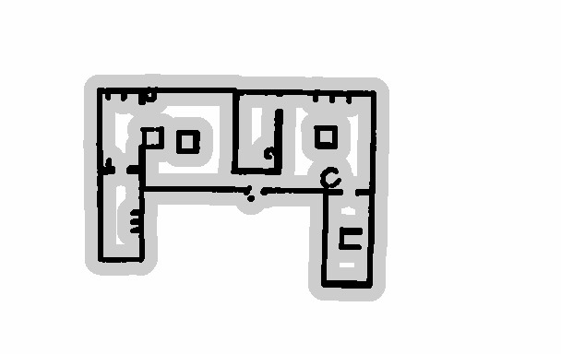

CHANGE DETECTION – Case:2
Obstacles
Detected Obstacle
PCA + K-Means
Change Map
Exit
Exit
Ground Truth Map
New Map (real-time with obstacle)
Notes:
Devesh:

Slide 26
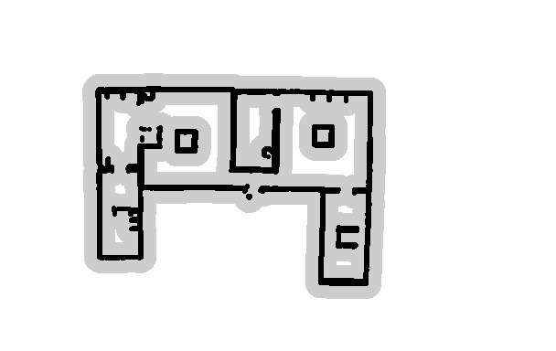

CHANGE DETECTION – Case:3
Obstacles
Detected Obstacle
PCA + K-Means
Change Map
Exit
Exit
Ground Truth Map
New Map (real-time with obstacle)
Notes:
Devesh:

Slide 27
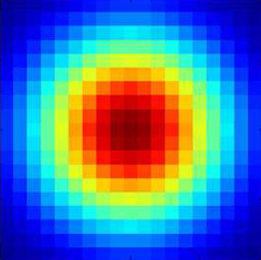
RISK EVALUATION WITH GRADIENTS
Change Map with the Gaussian
Notes:
2D Gaussian at set positions in a room
Penalizes the obstacle closer to the center

Slide 28
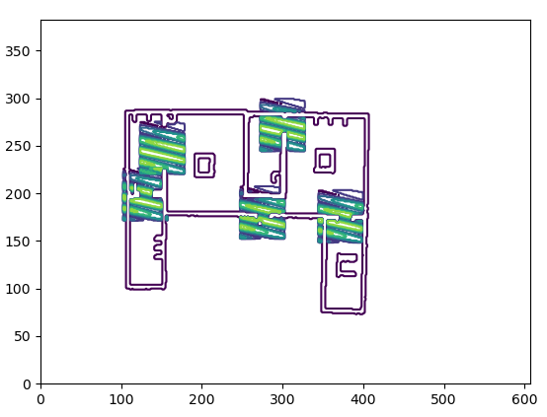
RISK EVALUATION WITH GRADIENTS
Gradient zone
Obstacles
Gradient map
Combining gradient and change map
Notes:
Akaash:

Slide 29
RISK SCORING
FACTORS:
Gradient Score
Change in Informed RRT* Path Length
Scenario 1: High gradient score, Change in path length
Scenario 2: Low gradient score, Change in path length
Notes:
Akaash:

Slide 30
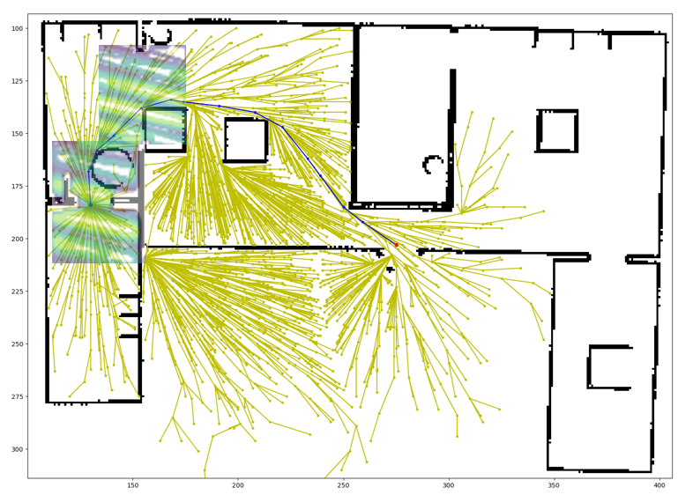
RISK SCORING
SCENARIO 1: HIGH GRADIENT SCORE, HIGH PATH LENGTH
Notes:
Akaash: label the obstacles

Slide 31
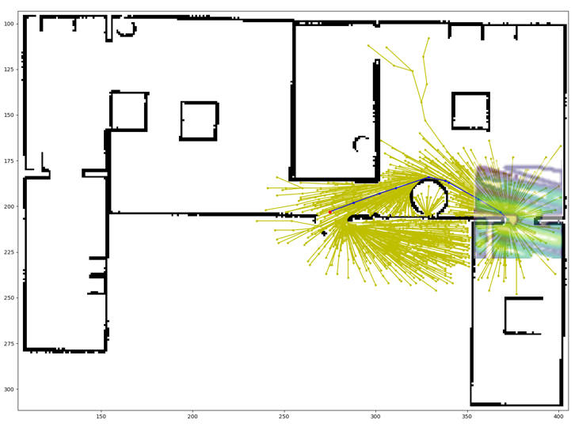
RISK SCORING
SCENARIO 2: LOW GRADIENT SCORE, HIGH PATH LENGTH
Notes:
Akaash:

Slide 32
RISK SCORE FORMULATION
Risk score = a * X + (1 - a) * Y
Where, a = 0.4 (empirically obtained)
X = Normalized Gradient Score
Y = Normalized path length score
Y = 0 if no change in path length
Notes:
Akaash:

Slide 33
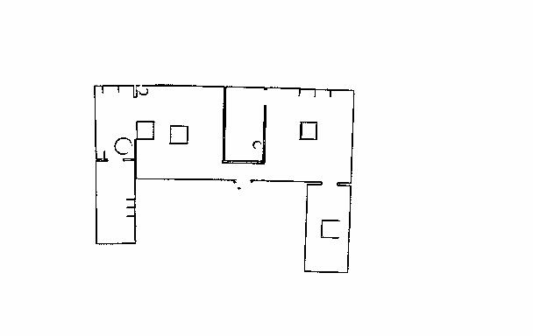

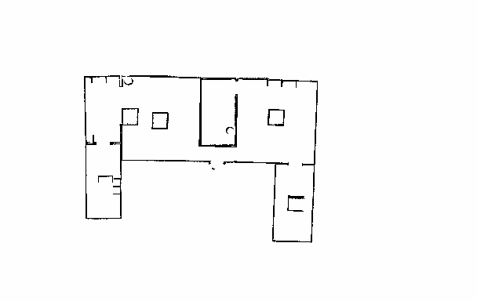
RESULTS
ROOM 5
ROOM 1
CASE-1
ROOM 2
ROOM 6
ROOM 5
Risk Score | Case - 1 | Case - 2 | Case - 3
Room 1 | 85% | 34% | 35%
Room 2 | 80% | 0% | 13%
Room 5 | 2 % | 1% | 2%
Room 6 | 0 % | 37% | 3%
ROOM 1
CASE-2
ROOM 2
ROOM 6
ROOM 5
ROOM 1
CASE-3
ROOM 2
ROOM 6
Notes:
Need to mark obstacles as red

Slide 34
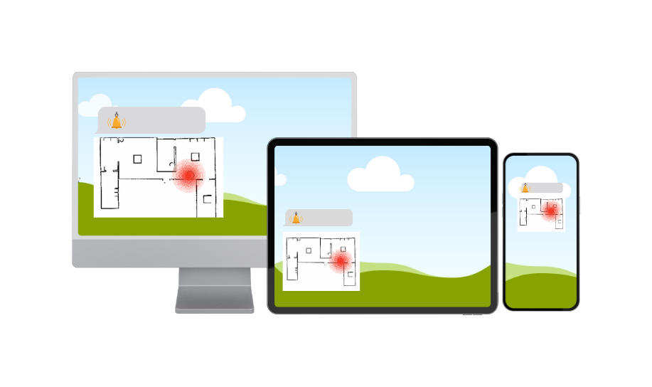
PUSH NOTIFICATIONs
Notify the end user
Notes:
Akaash:

Slide 35
STATE MACHINE
Rest
Scoring
Notifying
Mapping

Slide 36
FUTURE WORK
Scale To 3D
1
Push Notifications
4
Stakeholder Feedback
5
Improving Scoring
3
Testing On More Maps
2
Notes:
Akaash:

Slide 37
Thank you
Any questions?

Slide 38
Additional slides

Slide 39
GRADIENT SCORE – CASE 1
Change Map
Notes:
Issues with Risk Scoring

Slide 40
GRADIENT SCORE – CASE 2
Change Map
Notes:
Issues with Risk Scoring

Slide 41
GRADIENT SCORE – CASE 3
Change Map
Notes:
Issues with Risk Scoring

